Slide 1
Pedestrian Detection in Aerial Images
Computer Vision Project Report
By: Pranav Deep . I
Course Instructor : Dr Mrinmoy Ghorai

Slide 2
Contents
Motivation
About Data Set
Traditional CV
Harris Corner Detection
ORB
Keypoint Matching
Machine Learning - SVM
Deep Learning - Custom model
Experiments & Results
Bibliography

Slide 3
Motivation
India ranks 89th in disaster management according to World Risk Index (WRI) 2020, even lower than Sri Lanka, Bhutan & Maldives.
Search and Rescue Missions (SAR) missions in India is generally limited to Coast Guard or military operations only. (ISRO’s intervention in SAR missions has been a very recent trend, but mostly in case of high profile military operations like Indo-China border rescue missions etc.)
Local bodies(say Municipality) which has more statistics and information about the region has very limited resources and/or access to execute SAR missions during calamities or otherwise.
But all is not gloomy, as the procurement & setup cost of UAVs has significantly decreased.
However, automation in this domain is more/less not explored(Indian context).
To start with, I want to detect persons in aerial images in imagery that has been captured during calamity like scenario.

Slide 4






Heridal Dataset
Positive and Negative Samples
Image Size : 81 * 81
Channels : 3
+ve Images : ~29,000
-ve Images : ~32,000
Images are taken with a high resolution camera on the DJI Phantom 3, vertically at a 50 m altitude with the selected
Bigger Image Size : 3000*4000 (Used for feature matching)
+1
0
+1
+1
0
+1
Source

Slide 5
Traditional Computer Vision Techniques
Harris Corner Detection - Detects accurate corners [1] - Feature Extraction [1]
Oriented FAST and Rotated BRIEF (ORB) - Feature Extraction - Keypoint matching (In horizontally flipped images) - Person Detection based on Keypoint matching [2]
Experiments done with the aside mentioned methods

Slide 6
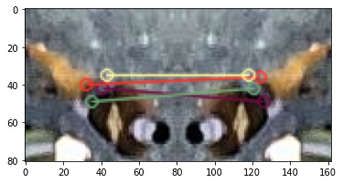
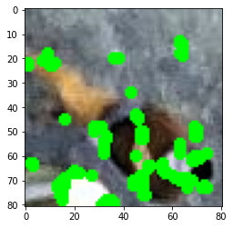
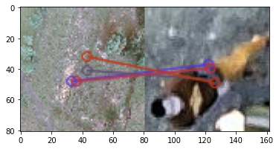
Keypoint Matching of horizontally flipped images
Harris Corner Detection
Feature Extraction from original images using keypoints of ORB Matcher
Source - [3]

Slide 7
Machine Learning Techniques
SUPPORT VECTOR MACHINE
Linear Kernel [4]
Radial Basis Function Kernel [5]
Polynomial Kernel [5]
Performed Classification
Experiments done with the aside mentioned methods

Slide 8
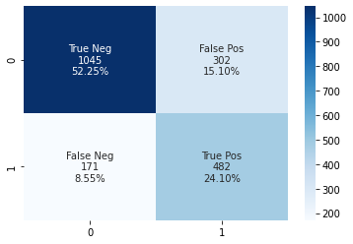
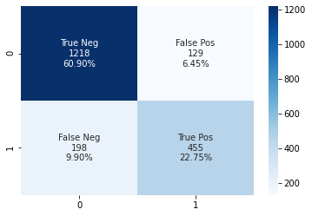
Confusion Matrices
Linear SVM
Polynomial SVM

Slide 9
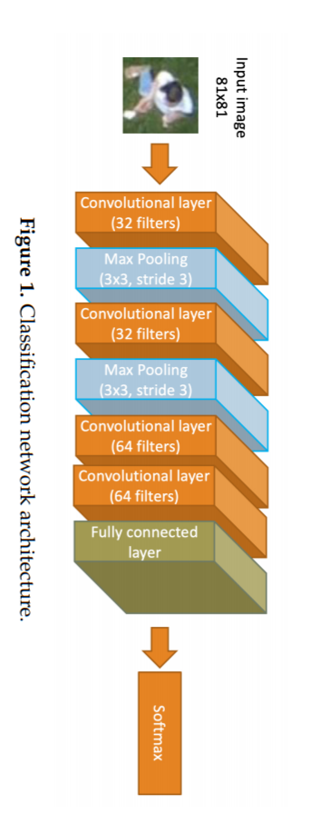
Deep Learning Classifier
Model Architecture
Changed final Activation fn. To sigmoid instead of softmax
Trainable params: 522,561
Epochs = 20
Batch Size = 32
Loss Fn. = Binary Cross Entropy
Optimizer = Adam
Used Dropout Layer - 0.5
Source [6]

Slide 10
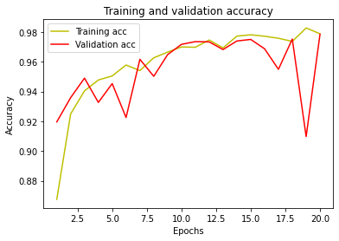
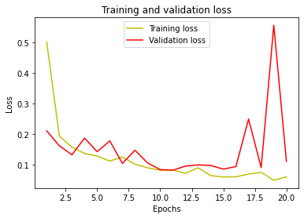
DL Model’s Accuracy and Loss plots

Slide 11
Results
Linear SVM
Polynomial SVM
DL Classifier
Training Accuracy | 100% | 96.7 % | 98.769 %
Validation Accuracy | NA | NA | 98.86 %
Testing Accuracy | 76.35 % | 83.65 % | 98.7611 %
Precision | 61.5 % | 77.9 % | 98.68 %
Recall | 73.8% | 69.7 % | 97.36 %

Slide 12
Bibliography
Han, Yuanfeng & Chen, Peijiang & Meng, Tian. (2015). Harris Corner Detection Algorithm at Sub-pixel Level and Its Application. 10.2991/iccse-15.2015.23. - Link
Rublee, Ethan & Rabaud, Vincent & Konolige, Kurt & Bradski, Gary. (2011). ORB: an efficient alternative to SIFT or SURF. Proceedings of the IEEE International Conference on Computer Vision. 2564-2571. 10.1109/ICCV.2011.6126544. - Link
Introduction to ORB (Blog) - Link
Xiaowu Sun, Lizhen Liu, Hanshi Wang, Wei Song and Jingli Lu, "Image classification via support vector machine," 2015 4th International Conference on Computer Science and Network Technology (ICCSNT), 2015, pp. 485-489, doi: 10.1109/ICCSNT.2015.7490795
Prajapati, G.L. & Patle, Arti. (2010). On Performing Classification Using SVM with Radial Basis and Polynomial Kernel Functions. 512-515. 10.1109/ICETET.2010.134. - Link
Kundid Vasić, M.; Papić, V. Multimodal Deep Learning for Person Detection in Aerial Images. Electronics 2020, 9, 1459. https://doi.org/10.3390/electronics9091459

Slide 13
Review
Please let me know how I can improve my coding, presentation and report writing skills or any other feedback?

